Slide 1
Statistics 367-1-4361 — Lecture 11
Frequentist Methods: Hypothesis Testing
Opher Donchin

Slide 2
8A Review

Slide 3
8C What is Hypothesis Testing

Slide 4
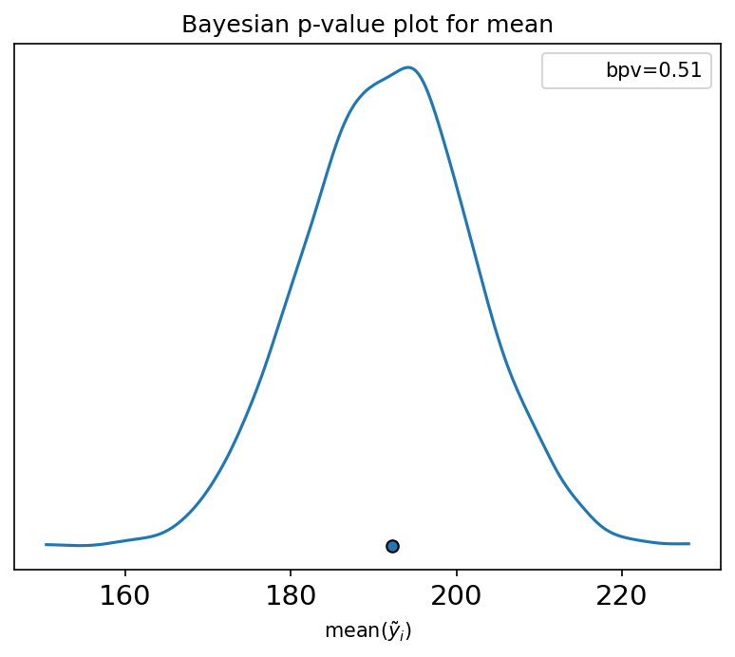
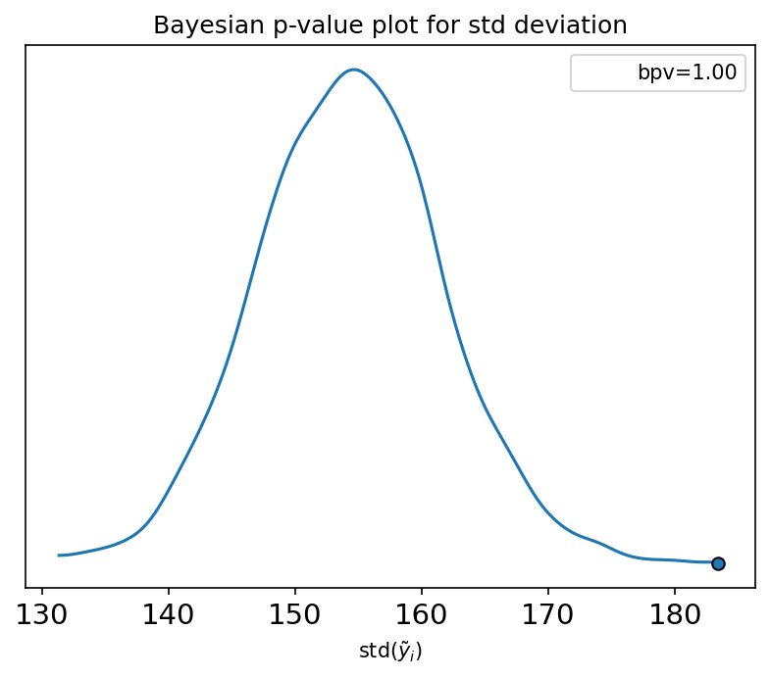
Bayeisian p values
Dot shows value of statistic calculated on observed data
Blue line is the posterior distribution of the statistic
A good fit:
Bayesian p value near 0.5

Slide 5
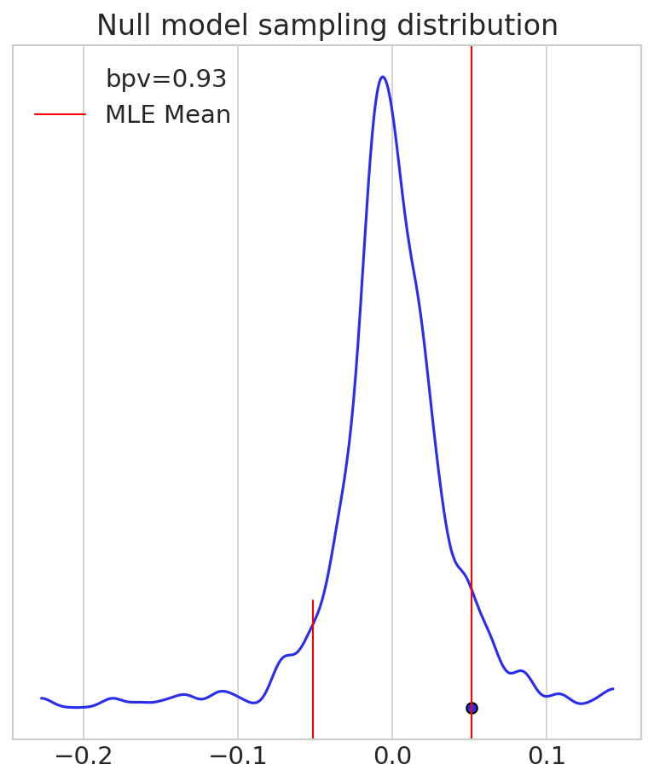
Sampling distributions for hypothesis testing
How easily could we get our data if null model is true?
If null model is true and we repeat experiment
How often will sample mean be further from 0 than my sample mean?
Consider positive and negative values
Called the frequentist p value
Or just the p value
If p<0.05, reject the null model

Slide 6
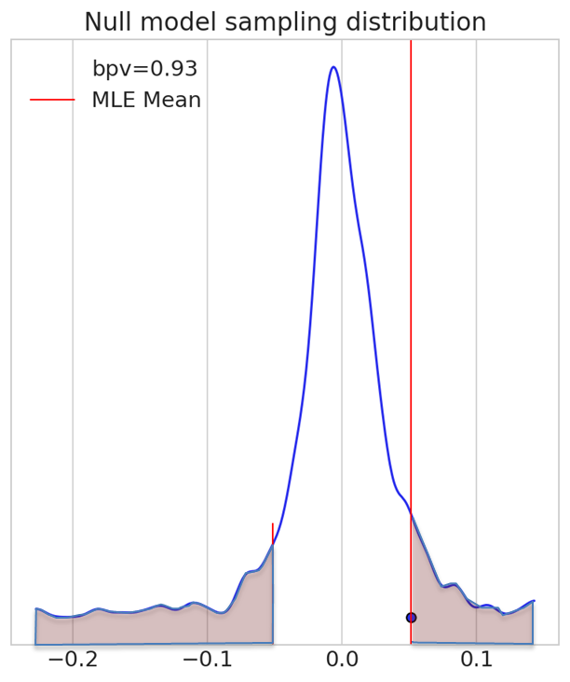


Frequentist p value is like Bayesian p value
Bayesian p value
Frequentist p value
Calculate using posterior
To test model fit
Succeed if $p≈0.5$
Calculate using a prior
Sharp around a null model
To reject the null model
Succeed if $p<0.05$

Slide 7
Hypothesis testing
Bayesian
Frequentist
Based on posterior
Given the data
Overlap with the ROPE?
Can accept or reject null
Lack of emphasis on threshold
Based on sampling distribution
Given null model
Overlap with the estimate?
Can only reject null
Emphasis on threshold
Usually 0.05 overlap

Slide 8
Frequentist hypothesis testing
Definition: Probability of data (or more extreme) given null
Emphasize: NOT probability of null being true
Frequentist logic vs. Bayesian logic
Visual: histogram of p-values under null

Slide 9
Examples of Null Priors in Practice — Which Example?
Example: Testing caffeine’s effect on reaction time
Alternative: Tips by smoker status

Slide 10
Different null hypotheses
One-sample: Compare mean of a single sample to known value
Paired: Compare before/after on same subjects
Independent: Compare means from two independent groups
Data structure and assumptions (normality, equal variance)

Slide 11
Section 2: t-Tests

Slide 12
Parametric estimation of sampling distributions
We can find the sampling distribution
Using bootstrap or parametric bootstrap
But for some estimators
Under some assumptions
We actually know the sampling distribution
It has an equation

Slide 13
The central limit theorem
The sum of iid random variables is normally distributed
This is true even if the random variables are not themselves normally distributed

Slide 14
The sample mean has a normal distribution
It is a sum of independent random variables
That all have the same distribution
This is true if there is enough data
Or if the data is normally distributed to start with

Slide 15
The normal distribution has two parameters
The mean and the variance
If we can find these, we know the distribution of the sample mean

Slide 16
The mean of the mean
The mean is an unbiased estimator
Easy to prove

Slide 17
The mean of the mean
The mean of the distribution of the sample mean equals its expectation
The sample mean is an unbiased estimator of the population mean
Easy to prove

Slide 18
The variance of the mean
This is the variance of the mean of a set of indepedent, identically distributed (iid) observations

Slide 19
The variance of the mean
The variance of the sample mean is directly proportional to the variance of the population
The larger the sample size, the smaller the variance of the sample mean
We didn’t require the population to be distributed normally or in any particular way.

Slide 20
Variance of the mean
To estimate the variance of the mean, we use our estimate of the variance of the population
se: standard error of the mean
Our estimate of the mean of the population:
Our estimate of the variance of the population:
Our estimate of the variance of estimate of the mean:

Slide 21
Estimate of the distribution of the sample mean
We can now estimate the distribution of the estimator

Slide 22
What did we learn?
The sample mean is distributed normally
Even if the data is not
If the sample size is large enough
The mean of the sample mean is:
the mean of the population
The variance of the sample mean is:
Proportional to the variance of the population
Inversely proportional to the sample size

Slide 23
4C Parametric confidence interval

Slide 24
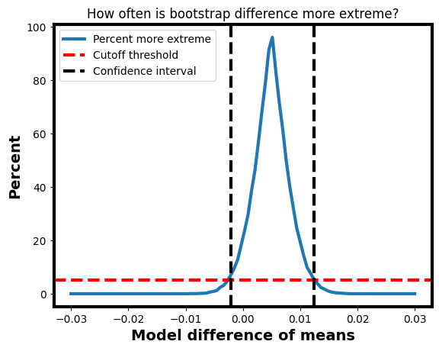
Review: Rule out unreasonable models
If a model has less than 5% chance of generating our data
Call it unreasonable!
This gives us a confidence interval
The range of differences in the population that could be considered reasonable
Given our model

Slide 25
Parametric confidence interval
We have some data
It has a sample mean
Which models of this data are unreasonable given this sample mean?
Which models produce a distribution of the sample mean for which this sample mean is unlikely?

Slide 26
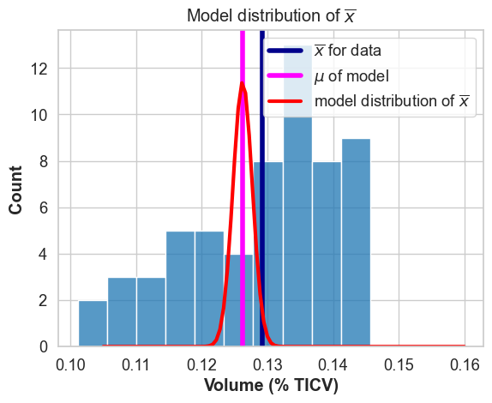
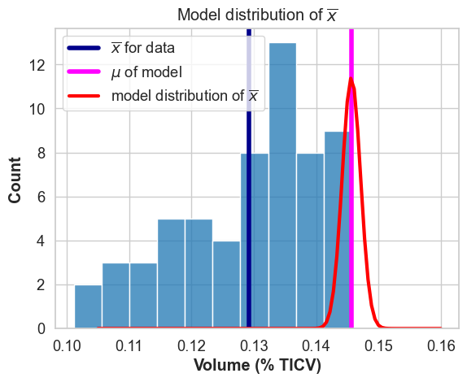
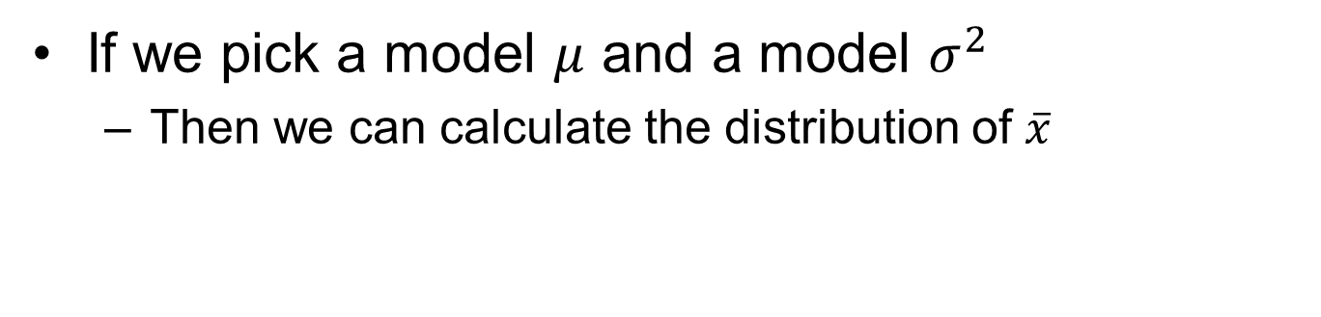
Any model has a distribution for the sample mean
If we pick a model $μ$ and a model $σ^{2}$
Then we can calculate the distribution of $\overline{x}$

Slide 27
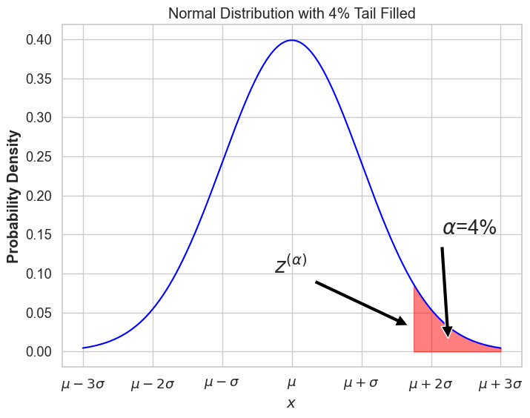
Defining the tail
Notation
We define a notation to allow us to specify the tail of a distribution

Slide 28
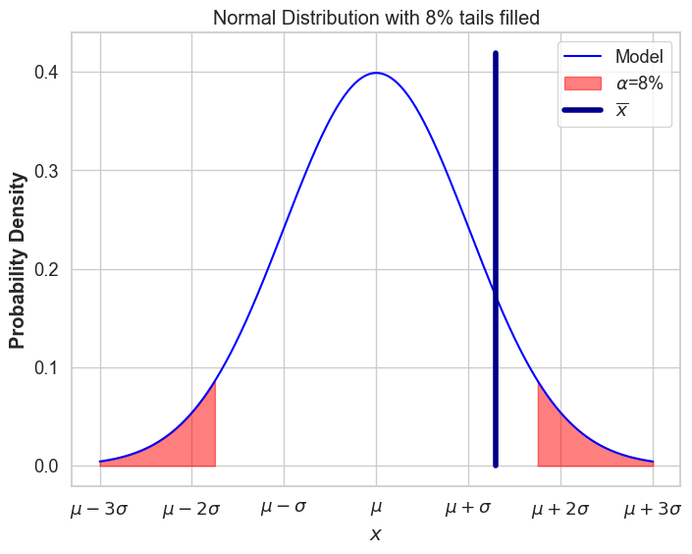
When is a model reasonable?
When the parameter falls inside the tails
Reasonable model
Condition for a reasonable model

Slide 29
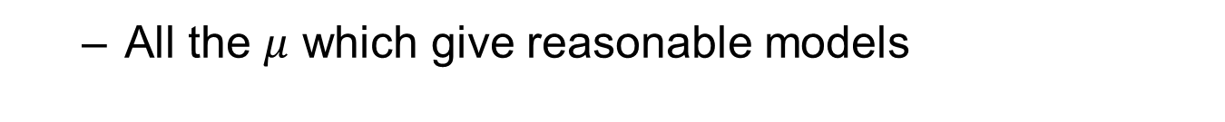
Confidence interval
All the $μ$ which give reasonable models
Define the inverse function for a standard normal
Then:
And:

Slide 30
Confidence interval
All the $μ$ which give reasonable models
So we can rewrite the confidence interval as:

Slide 31
Solve for interval
All the $μ$ which give reasonable models

Slide 32
Estimate standard deviation
Using the standard error of the mean

Slide 33
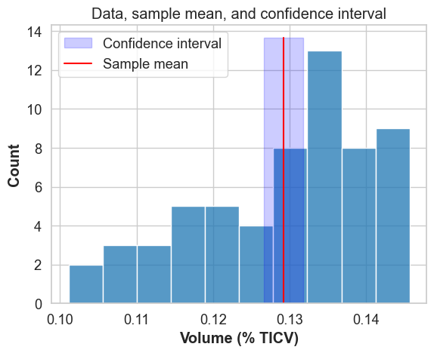
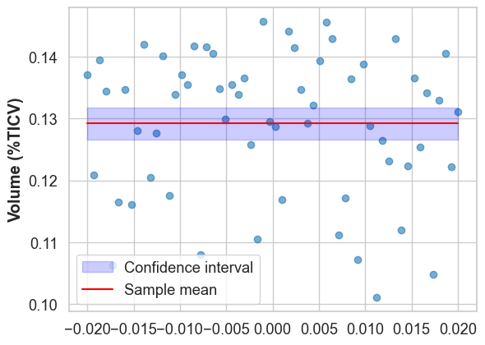
Back to the example
Calculate the confidence interval using the equations above

Slide 34
What have we learned?
How to generate confidence interval for sample mean
Or any other normally distributed statistic

Slide 35
4D Fully worked example

Slide 36
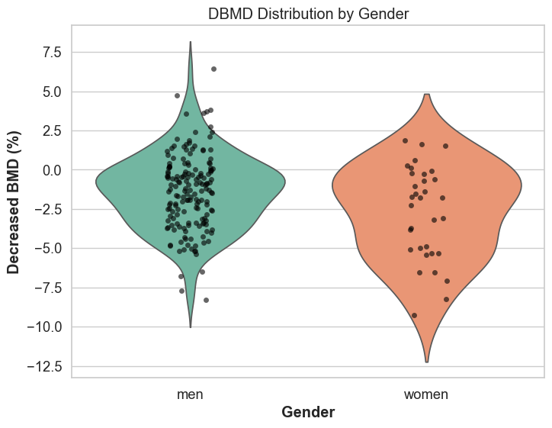
Density of bone minerals
Bone minerals decline with age
More in women than in men
Look at samples from 45-49 year olds

Slide 37
Effect sizes
Means:
Men -1.39%, Women -2.72%
Raw effect: 1.33%

Slide 38
Normalized effect size
Raw effect: 1.33%
Combined sd: 2.49
Cohen’s d: 0.53

Slide 39
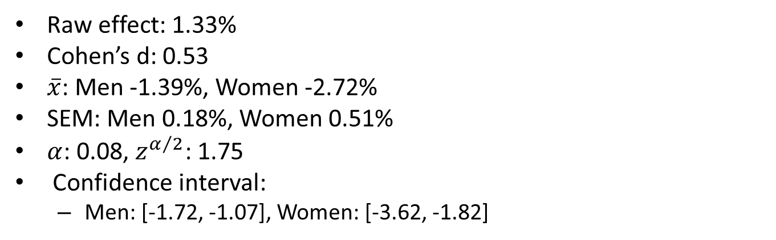
Confidence intervals
Raw effect: 1.33%
Cohen’s d: 0.53
$\overline{x}$: Men -1.39%, Women -2.72%
SEM: Men 0.18%, Women 0.51%
$α$: 0.08, $z^{α/2}$: 1.75
Confidence interval:
Men: [-1.72, -1.07], Women: [-3.62, -1.82]

Slide 40
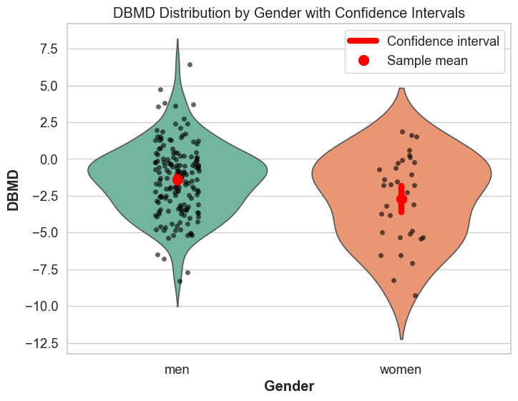
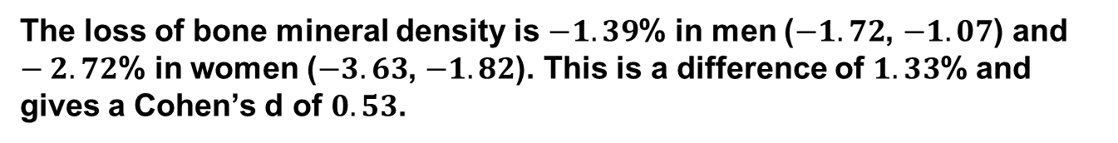
Putting it together
Picture plus text
The loss of bone mineral density is $−1.39$% in men ($−1.72$, $−1.07$) and $−2.72$% in women ($−3.63$, $−1.82$). This is a difference of $1.33$% and gives a Cohen’s d of $0.53$.

Slide 41
4E Confidence intervals and the t distribution

Slide 42
95% Confidence interval:
For parameters outside the confidence interval
Data like ours (our data or more extreme) happen less than 5% of the time
The 5% tails of the bootstrap on our data give us the 95% confidence interval
We can range over all possible parameter values and figure out which data is extreme for those parameters
We can just as well generate the bootstrap of the mean for our data and take the 5% tails

Slide 43
Test accuracy of confidence interval
Let’s generate data and see if our confidence interval works
Generate a sample of size 10 from N(0,1)
Calculate the confidence interval and see if it contains 0
Should it contain 0?
How often?

Slide 44
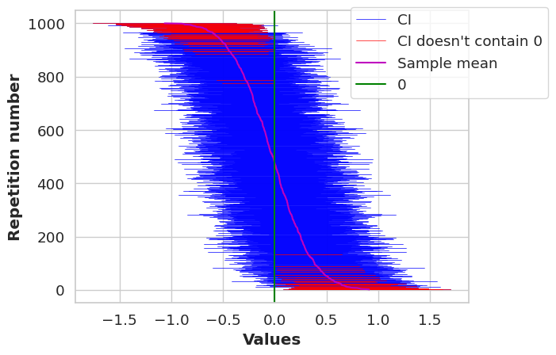
Test accuracy of confidence interval
Let’s generate data and see if our confidence interval works
Generate a sample of size 10 from N(0,1)
Calculate the confidence interval and see if it contains 0
Repeat 1000 times and count the number of times 0 is in the confidence interval

Slide 45
The problem
Let’s generate data and see if our confidence interval works
Generate a sample of size 10 from N(0,1)
Calculate the confidence interval and see if it contains 0
Repeat 1000 times and count the number of times 0 is in the confidence interval
87 cases where 0 is outside the confidence interval
This is a little more than we expected (50)
Is it a lot more?

Slide 46
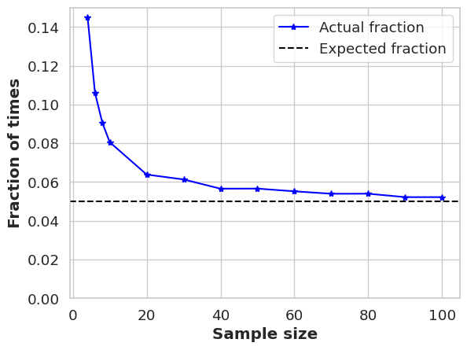
The problem
We’ll look at the percentage of times that 0 is outside the confidence interval as a function of the sample size N
We have a reasonable approximation of a 95% confidence interval for N > 40

Slide 47
The problem: estimated variance
Because the estimate depends on the sample mean

Slide 48
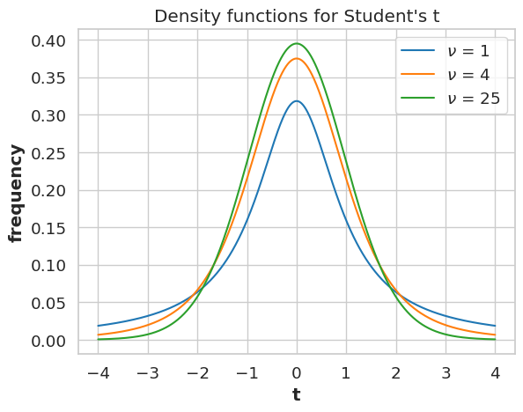
The Student’s t distribution
The t distribution is actually a family of distributions
Parameterized by υ=N-1, the degrees of freedom
It can be described with a formula
We won’t use the formula
Thicker tails than the normal distribution (positive kurtosis)

Slide 49
t distribution for confidence intervals
We can build the confidence interval just like before

Slide 50
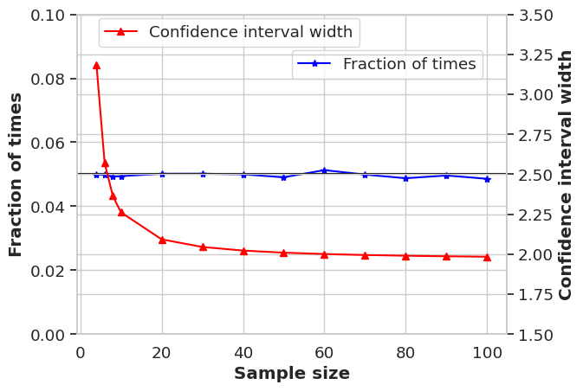
Corrected confidence interval passes test
We can build the confidence interval just like before, but just use a different number to multiply the standard error estimate

Slide 51
What have we learned
Our previous estimate of confidence interval was wrong
Because we are estimating mean and variance
The ratio is actually distributed t
We can now calculate a correct confidence interval
Using t distribution

Slide 52
5A Distribution of the sample variance

Slide 53
Distribution of the sample variance
We can easily find the distribution of the sample variance
Take a sample from the model
Calculate the sample variance
Repeat many times

Slide 54
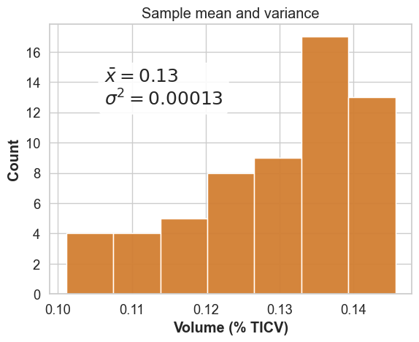
Sample variance is an estimator
The sample variance estimates the population variance

Slide 55
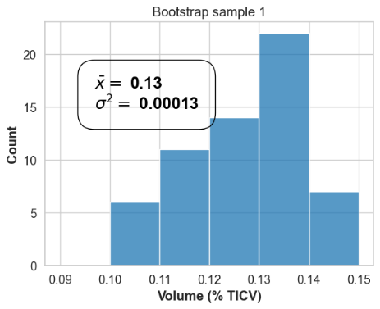
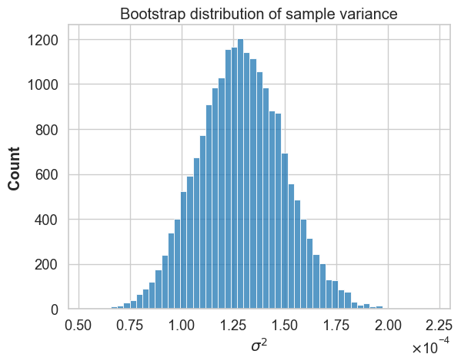
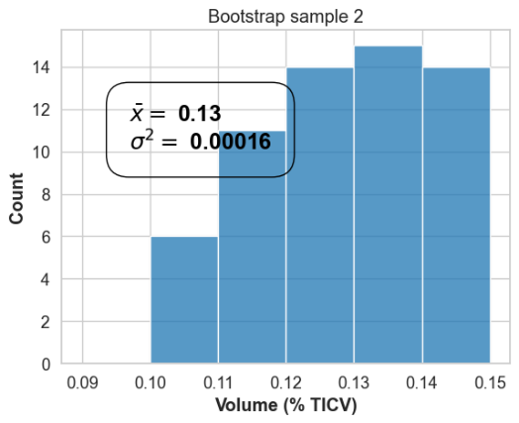
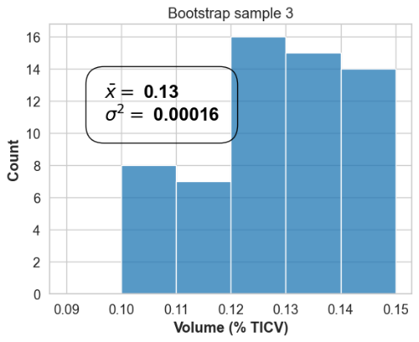
Bootstrap the sample variance

Slide 56
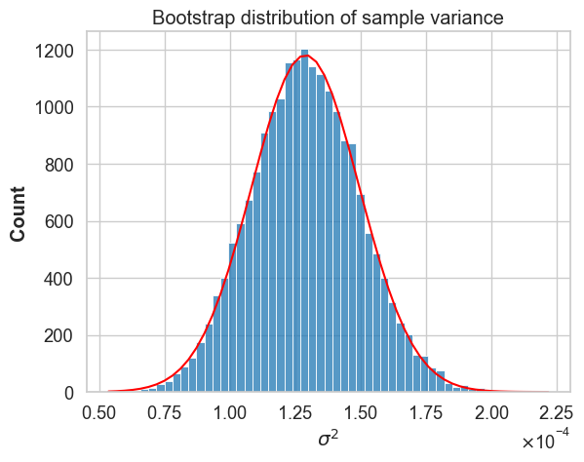

Bootstrap the sample variance
The distribution of the sample variance looks normal
But this may be because we have such a big data set
N = 313

Slide 57
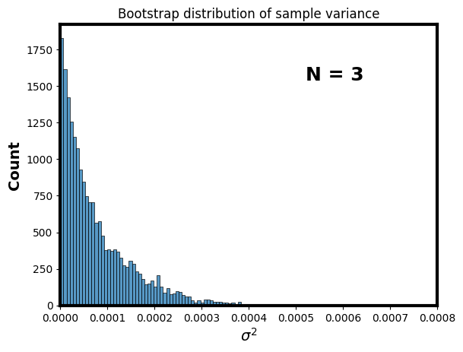
Bootstrap with different Ns
Instead of taking N the same as the data, take different Ns

Slide 58
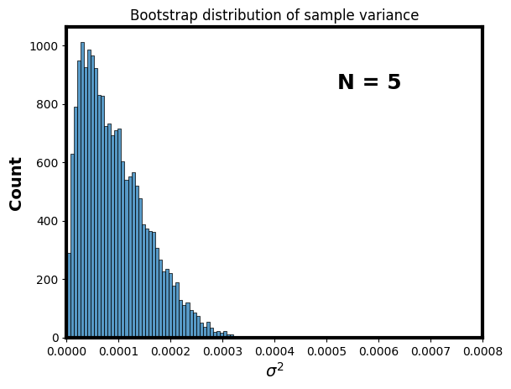
Bootstrap with different Ns
Instead of taking N the same as the data, take different Ns

Slide 59
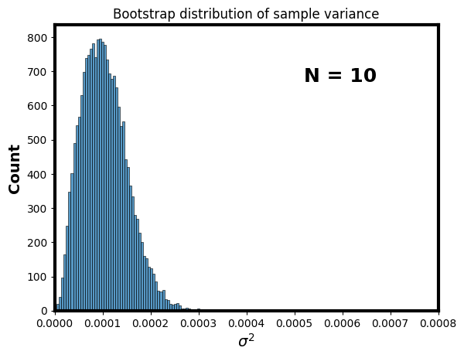
Bootstrap with different Ns
Instead of taking N the same as the data, take different Ns

Slide 60
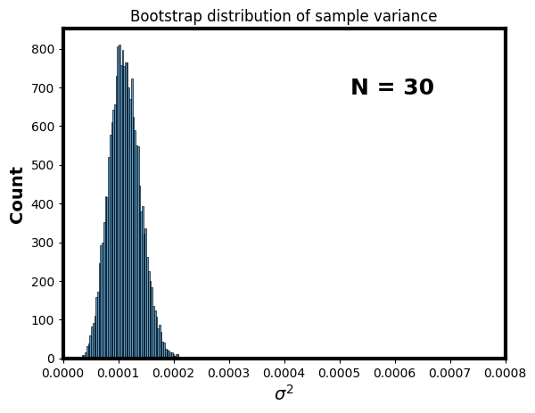
Bootstrap with different Ns
Instead of taking N the same as the data, take different Ns

Slide 61
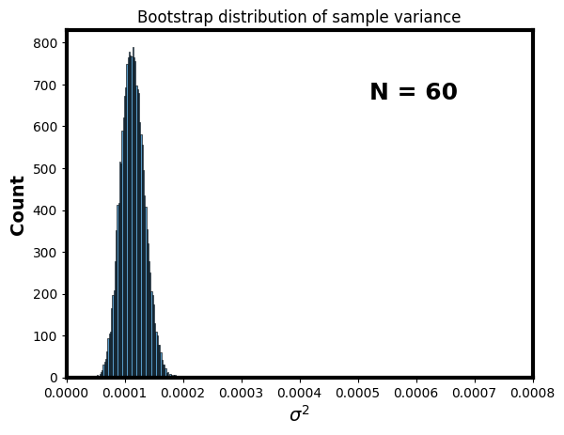
Bootstrap with different Ns
Instead of taking N the same as the data, take different Ns

Slide 62
Shape of distribution changes

Slide 63
What have we learned?
We can use bootstrap to find distribution of the sample variance
For large N, this distribution seems Gaussian
For small N, the distribution has positive skew
As N gets bigger, our estimate gets more accurate

Slide 64
Hypothesis tests
We want to test an assertion
Usually an assertion about differences
Examples:
The population mean is greater than 0
The treatment causes a change in the median
Boys have less variable reaction times than girls

Slide 65
Hypothesis tests
We want to test an assertion
We want to test this by sampling the population and doing parameter estimates
Sampling the population is the only way to test any hypothesis
After we sample, making parameter estimates is the only way to say something about the population

Slide 66
Hypothesis tests
We want to test an assertion
We want to test this by sampling the population and doing parameter estimates
Our basic strategy:
Compare two models
Null model
A model in which the assertion is false
Effects model
A model which includes the effect

Slide 67
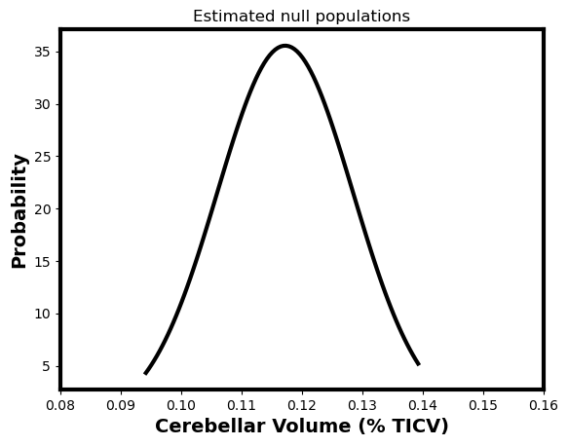
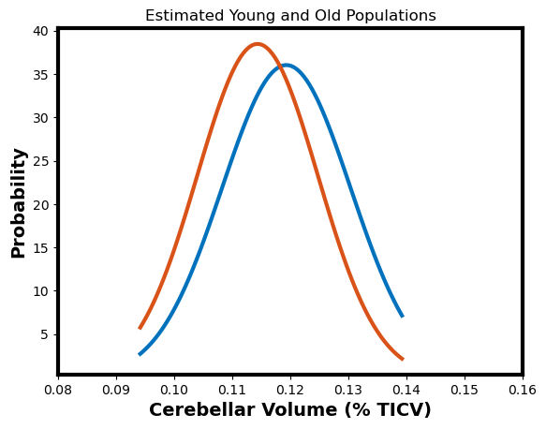
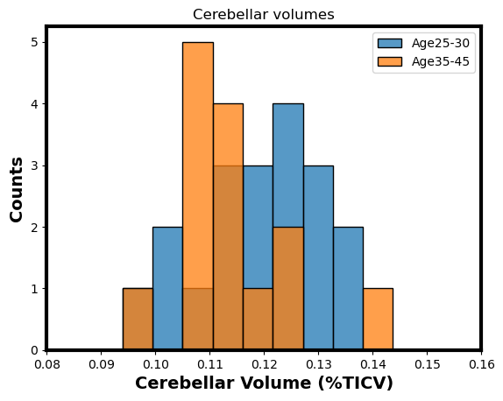
The null and alternative models
Null model: the two groups are the same
Alternative model: the two groups are different

Slide 68
Hypothesis tests
We want to test an assertion
We want to test this by sampling the population and doing parameter estimates
Our basic strategy: compare null and effects models
Our weird approach
We either reject the null model or fail to reject
We never “accept” the effects model

Slide 69
Two kinds of error
Type I error / α error
Falsely rejecting a true null model
The null model says only one population
Rejecting this: saying there must be two
False rejection: saying there must be two when there is really only one
Making unwarranted conclusions
The probability of type I error is the significance of the test

Slide 70
Two kinds of error
Type I error / α error
Falsely rejecting a true null model
Type II error / β error
Failing to reject a false null model
The null model is that there is only one population
If false, then there are really two
Failing to reject means overlooking a real difference

Slide 71
Two kinds of error
Type I error / α error
Falsely rejecting a true null model
Type II error / β error
Failing to reject a false null model
Overlooking a real difference
Being overly cautious
Related to the power of the test
The smaller the probability of type II error, the more powerful the test

Slide 72
Significance threshold
Completely arbitrary level of significance
For which we reject the null model
Most often set to 5%
0.05 chance for type I error
1 in 20 we reject the null model even though it’s true
We set to 8%

Slide 73
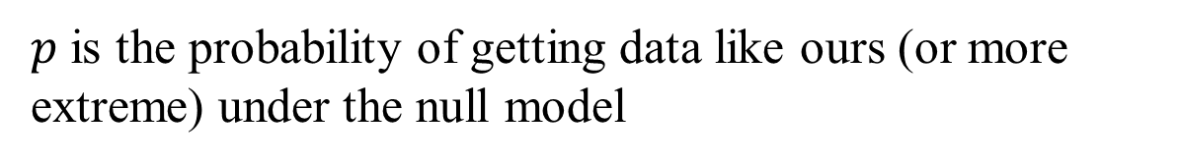
Significance level
Also called p
Equal to type 1 error
$p$ is the probability of getting data like ours (or more extreme) under the null model
Can also find the probability of getting null model estimator from bootstrap model

Slide 74
What we learned
What are null and effects models
Models of 1 or 2 populations
What is a hypothesis test
An effort to reject the 1 population model
What do significance and power mean?
Significance: how small is the chance for overselling
Power: how big is the chance to find things
What is a p value
A threshold for significance

Slide 75
5F Confidence intervals and hypothesis tests

Slide 76
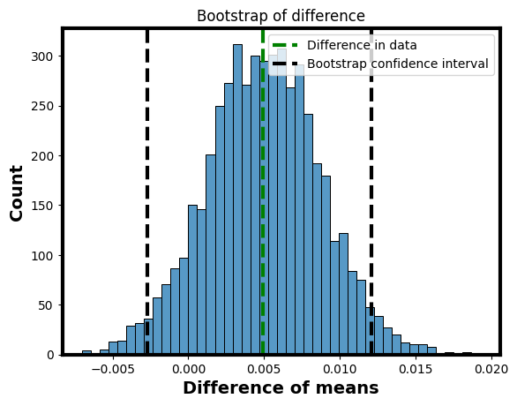
What is a confidence interval?
A range of possible models that are not unreasonable
Models under which our data is not extreme

Slide 77
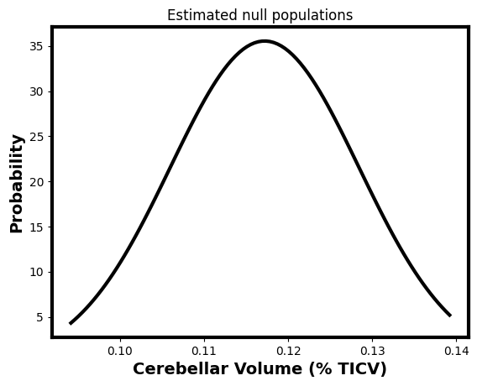
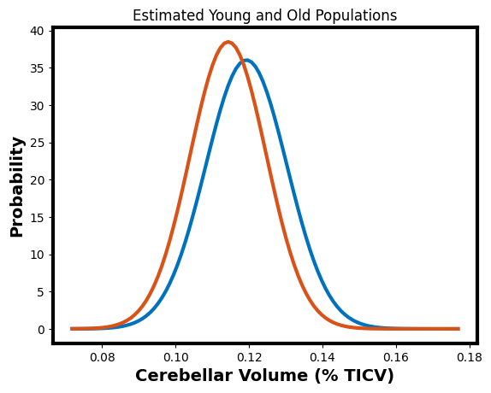
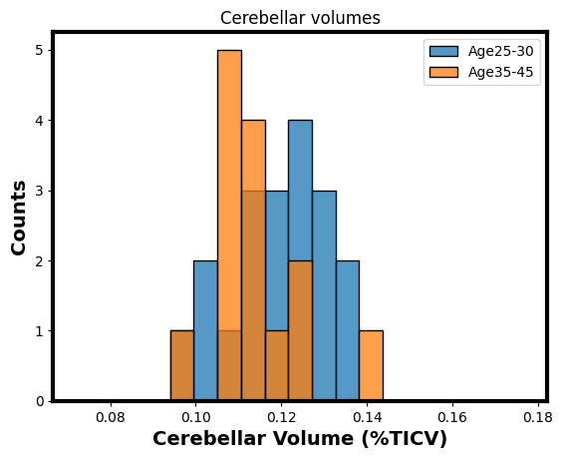
What is a hypothesis test?
Can we reject the null model?
Such that type 1 error is small

Slide 78
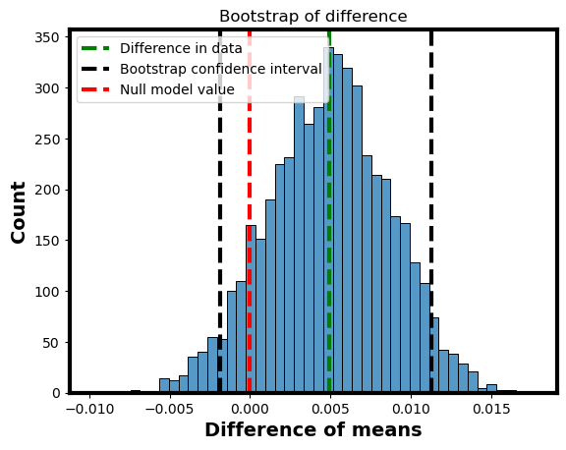
Do a hypothesis test with confidence interval
Add the null model to our graph
The null model falls well within the confidence interval
What does that mean?

Slide 79
I want to know the probability of getting data like mine given the null model
When I say data like mine, I mean like mine or more extreme
How often is (null estimator – null mean) < (my estimator – null mean)
I would like to generate the distribution of the estimator under the null model
And ask how often data like mine or more extreme happens

Slide 80
Do a hypothesis test with confidence interval
Add the null model to our graph
The null model falls well within the confidence interval
What does that mean?
Probability that difference is less than 0 or greater than 0.01:

Slide 81
Traditional and improved practice
Traditional practice
Just report the hypothesis test
“The results proved significant at the p<0.05 level”
Slightly better
Report the actual type 1 error level
“The results proved significant with p=0.045”
“Thre results proved significant with p=0.001”

Slide 82
Traditional and improved practice
Improved practice
Report actual difference, effect size and significance
“The difference of 0.005 represented an effect size of 0.44 which was not significant (p = 0.11)”
Even better
Report the actual difference, confidence interval and effect size
“The difference of 0.005 (CI: -0.03-0.12) represented an effect size of 0.44.”

Slide 83
What did we learn
We can use confidence intervals to do hypothesis tests
Important to report effect size as well as significance
Even better to report effect size and confidence interval
Try not to do significance tests

Slide 84
5G Issues with hypothesis testing

Slide 85
Issues with type 1/2 error
Null model is probably never exactly true
There is always some difference in height
There is always some effect of treatment
Effect sizes really matter
All science is provisional

Slide 86
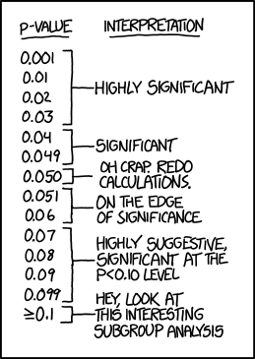
p values are dichotomous
What to write in your scientific paper
https://xkcd.com/1478/

Slide 87
Statistical significance doesn’t measure effect size
Too much precision can lead to significance for meaningless effects
Increasing life expectancy by a day
Affecting height by 2 mm
Not enough precision can lead to insignificance for large effects
If N is small or data is noisy, confidence interval can be broad
Measures of well being
Noisy biological measures

Slide 88
Failure to reach significance
Not enough precision can lead to insignificance for large effects
Data can fail to be significant even if there is a large effect
Lack of significance doesn’t mean no effect

Slide 89
Comparing significance isn’t significant
Treatment has a significant effect on patients
Treatment has no significant effect on controls
Does treatment affect patients and controls differentially?
Not necessarily!!

Slide 90
Significance can be cheated
We will learn how to cheat at the end of the course
P-hacking

Slide 91
Significant estimates are biased upwards
Because only large effects are significant!
So looking only at significant results biases the results

Slide 92
An alternative interpretation
The null model is always wrong
Lack of significance
There is not enough information in the data
Even to reject the null model
Significance
There is enough information to consider alternative models

Slide 93
What we learned
Issues with statistical significance and null model hypothesis testing
Type 1 and type 2 error aren’t enough information
The null hypothesis is always wrong
Effect sizes matter
Statistical tests are dichotomous, but reality is fuzzy
Large effects can be insignificant
If data are noisy or samples are small
Significance biases effect sizes
Differences in significance aren’t meaningful
Must compare the things you care about directly

Slide 94
What to do?
Plot your data
Make your comparisons clear
Consider raw and normalized effect sizes
Think in the units of the actual problem
Keep in mind the precision of your measurements
Compare differences to noise levels
Use common sense

Slide 95
One-Sample t-Test (Caffeine Reaction Times)
Key assumptions: Normality of differences; Independence
Visual: histogram of sample, prior predictive distribution

Slide 96
Paired t-Test (Sleep Study)
Key assumptions: Normality of differences; repeated measures
Visual: scatter plot of pre/post

Slide 97
Independent t-Test (Tips by Smoker Status)
Key assumptions: Normality in each group, equal variance (or Welch’s test)
Visual: boxplot of tips by group

Slide 98
Summary Table Comparing t-Tests
Rows: test type; Columns: assumptions, data structure, key points
Use concise bullet points or table layout

Slide 99
Interpreting Frequentist p-Values
p-value ≠ probability the null is false
p-value measures data compatibility with null
Relate to prior predictive checks

Slide 100
Contrast with Bayesian Posterior Difference
Example: Visualize posterior difference with ROPE
Compare posterior probability of effect size to frequentist logic

Slide 101
Misinterpretations — Key Points
Misconception 1: p < 0.05 means the effect is real
Misconception 2: p-value is the probability the null is false
Emphasize: Frequentist methods do not assign probability to hypotheses

Slide 102
Section 3: Common Misinterpretations of the p-Value

Slide 103
Real-World Examples of Misinterpretations
Suggested resources:
Ioannidis, J.P.A. (2005). 'Why Most Published Research Findings Are False'
Goodman, S. (2008). 'A Dirty Dozen: Twelve P-Value Misconceptions'
Search 'p-value misconceptions in medical research'

Slide 104
How to Avoid p-Value Pitfalls
Use effect sizes with confidence intervals
Report all relevant tests, not just significant ones
Pre-register hypotheses and analyses
Visualize data distributions

Slide 105
Introduction to F-Test for Slope
Used for testing if β = 0 in regression
Relation to ANOVA

Slide 106
Dataset Example: Bikes (Temperature → Rentals)
Visualize scatter plot: rentals vs. temperature
Show linear model overlay

Slide 107
Section 4: F-Test for Null Slope

Slide 108
F-Test Output and Interpretation
Emphasize F-statistic vs. Bayesian slope posterior
Interpretation: p-value ≠ probability slope is nonzero

Slide 109
Visual Comparison: F-Test vs. Bayesian Posterior
Show side-by-side: posterior distribution over β vs. F-statistic

Slide 110
Dataset Example: Rugged (GDP vs. Ruggedness, Continent)
Visualize scatter plot: GDP vs. ruggedness by continent

Slide 111
Section 5: Multiple Regression

Slide 112
When to Use Multiple Regression
Predict outcome with >1 predictor
Discuss assumptions: multicollinearity, normality
Discuss normalization

Slide 113
Dataset Example: Bikes (Two Predictors)
Predict rentals using temperature and humidity

Slide 114
Frequentist Multiple Regression Output
p-values per slope coefficient
Contrast to Bayesian model that treats coefficients as distributions

Slide 115
Bayesian Posterior Comparison
Visualize credible intervals vs. confidence intervals

Slide 116
Summary Slide: Key Takeaways from Lecture 2
Frequentist tests as prior predictive checks
p-values as data compatibility under null
t-tests: assumptions and appropriate uses
Visualize differences with Bayesian models

Slide 117
Questions and Discussion

Slide 118
Section 6: Summary and Discussion

Slide 119
Next Lecture Preview: ANOVA and Beyond

